Slide 1
Access eJournals Form Your Home
Through Web –Proxy
Implemented & Configured
by
Information Technology Division - OUSL

Slide 2








Web-proxy
This New service allows you to access all e-journals from their home as a OUSL registered intranet user

Slide 3
Preparation to access to the service
To get the service you need to fulfill following requirements
1. Enable proxy facility in your web browser
proxy IP = 192.248.73.15
proxy port = 8080
( see next slide for details)
You have to get web proxy login account details via OUSL Library
Please contact Library / ext 530 or 564

Slide 4

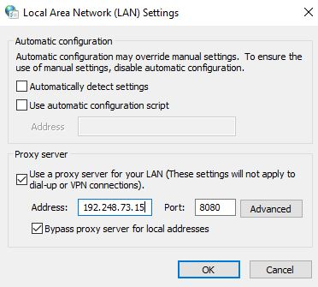
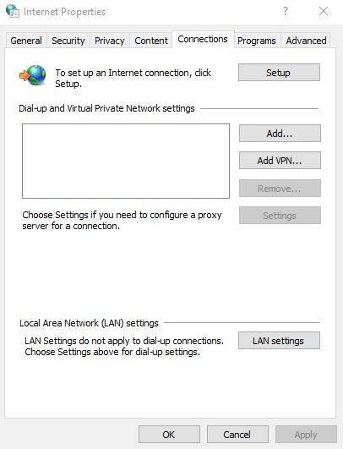
Enable proxy facility in your web browser
If you use Internet Explorer or Google Chrome, you have to add proxy settings on LAN settings in internet options in tools menu
Click LAN Settings, put a tick on Proxy server option and add 192.248.73.15 as the Address
8080 as the port.

Slide 5

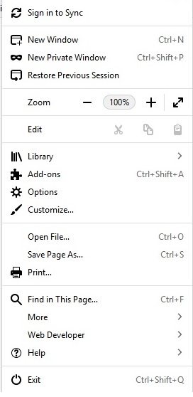
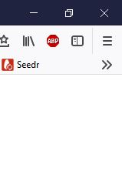
Web-proxy
If you use Firefox
Click on this icon
and it opens this dialog box

Slide 6
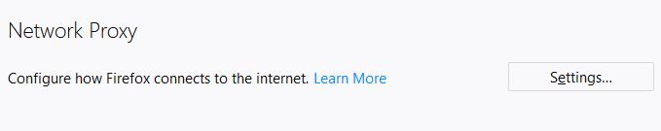
Web-proxy
Click “Options” and then scroll down and find Network Proxy ,

Slide 7
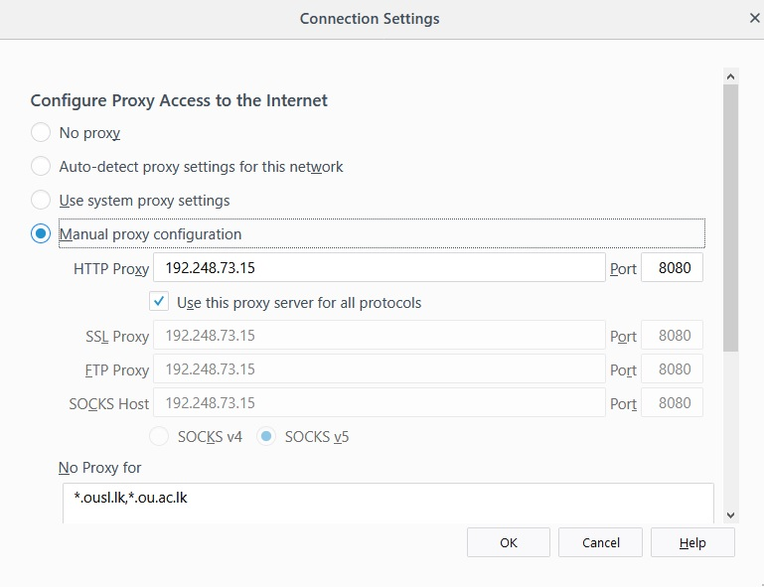
Web-proxy
Click on “Settings” and it will open Connection Settings Dialog Box . Select Manual proxy Configuration and enter.
Type 192.248.73.15 as the HTTP Proxy, 8080 as the port. Put the check near to the “Use this proxy server for all protocols” and Click “OK”

Slide 8
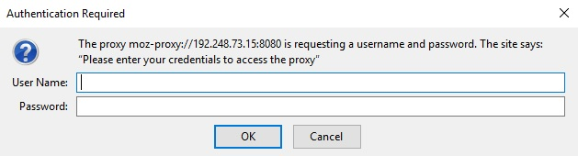
Web-proxy
Then restart your browser. After restarting the browser, it will prompt you a authentication dialog box.
When authentication dialog box appears enter your logging details and click “OK”

Slide 9
Now you can access the service, Just click library site http://lib.ou.ac.lk and access the ejournals

Slide 10

Web-proxy
After authenticate you can easily access “lib.ou.ac.lk” and click “E-Journals Databases”

Slide 11

Web-proxy
Then you can access any of the “e-journal” links in that page

Slide 12
IF you need further assistance please contact
  Ext: 664 or 530

Slide 13
Web-proxy
Thank You

